Slide 1
SAAM
Software architecture analysis method
http://slashnode.wikidot.com/seng4420-lect07

Slide 2
Software Architecture Analysis Method (SAAM)
SAAM is a method to determine the degree to which an architecture meets its goals. It is used for:
  Validation during development / testing
  A benchmark when acquiring software
  Comparing architectures

Slide 3
Assessments and Scenarios
A assessment is completed using scenarios. A scenario is a brief description of a single interaction of a stakeholder with a system.
A sequence of steps involving the use or modification of the system
Not necessarily a run-time interaction
Scenarios test quality attributes, for example:
  By proposing specific changes to be made to a system - modifiability
  By proposing specific threat actions - security
  By proposing usage profiles that tax resources - performance
Quality attributes do not exist in isolation; the context of them is important. For example - a UI is carefully designed so that a novice user can use the system with minimal training, but what if experienced users find it tedious?

Slide 4
SAAM Steps
Develop scenarios
Classify scenarios
Perform scenario evaluations
Reveal scenario interaction
Overall evaluation

Slide 5
Steps
1. Develop scenarios
We do this by capturing the system's expected qualities, uses and users.
Scenarios represent tasks relevant to different stakeholders; therefore, we must:
  Involve all stakeholders
  Involve experts
2. Classify scenarios
Scenarios can be divided into two groups:
  Direct scenarios - can be "walked through" the architecture
  Indirect scenarios - require modification to the system (ie: extra components & connectors)

Slide 6
Steps - continued
3. Perform scenario evaluations
For each scenario list which components and/or connections need to be altered, along with:
  A weighting of the difficulty of the change(s)
  Estimated cost of the changes
  A description of the set of changes required
4. Reveal scenario interaction
When different indirect scenarios require the same component to be changed, these scenarios are said to interact with the component. This exposes the allocation of functionality to components (especially if the scenarios are semantically unrelated).
High interaction between semantically unrelated scenarios indicates:
  Low cohesion
  High structural complexity
High interaction between semantically related scenarios indicates high cohesion.

Slide 7
Finally …
5. Overall evaluation
If we are comparing architectures:…
A "importance-weight" should be assigned to each scenario and the scenario interactions. This is a subjective process involving all of the stakeholders of the system.
The weighting is used to determine an overall ranking of candidate architectures

Slide 8
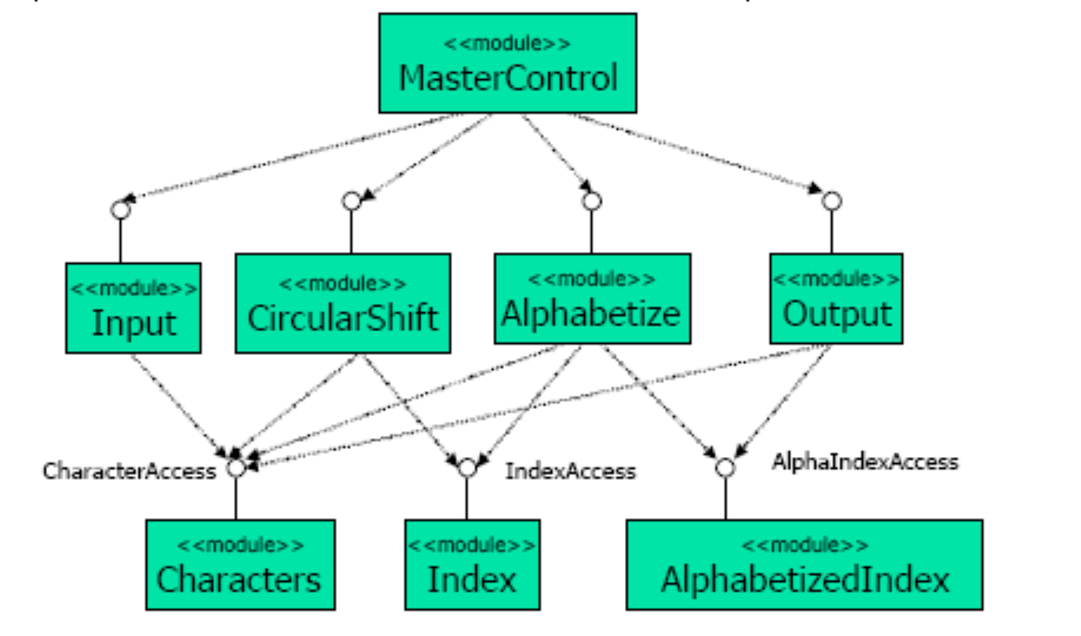
An application of SAAM
Analyze the shared-memory architecture for the Keyword in Context system
The Keyword In Context System (or KWICS) takes a set of text lines as input. It then produces all circular shifts of these lines and alphabetizes the results.

Slide 9
Developing scenarios
KWICS has two stakeholders. The end user and the developer.
Scenarios (all indirect):
  Scenario: Make KWICS operate in an incremental rather than batch fashion (accept one sentence at a time and produce the keyword index for all sentences given to date)
  Scenario: Make KWICS eliminate entries beginning with noise words (articles, pronouns, prepositions and conjunctions)
  Scenario: Change the internal representation of the sentences (ie: compressed or uncompressed)

Slide 10

3 Examples
Scenario 1: Make KWICS operate in an incremental rather than batch fashion
This will most likely require modification of:
  Input: to yield control to MasterControl after each sentence.
  MasterControl: to loop over subordinate modules for each sentence.
  Alphabetizer: to use incremental sorting rather than sorting all at once.

Slide 11
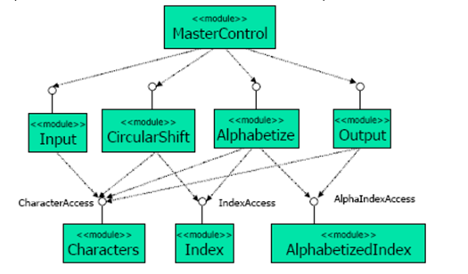
3 Examples
Scenario 2: Make KWICS eliminate entries beginning with noise words
Probably will require modification of:
  CircularShift : to delete those sentences beginning with 'noise' words.

Slide 12
3 Examples
Scenario 3: Change the internal representation of the sentences
Will require modification of:
  Characters: needs to be changed to handle compressed data
  Note: as all modules use Characters all modules (other than MasterControl) may need modifying.

